Slide 1

AIML Natural Language Processing (NLP) Application Capstone Project Automated Ticket Assignment 19th Apr 2020
Gaurav Walia
Karishma Dcosta
Lavanya Harry Pandian
Kumari Pallavi
Swati Tyagi
Group 3, Batch: Apr 2019 –Apr 2020
Project Guide: Sanjay Tiwary Program Manager: Anurag Shah

Slide 2
Capstone Project
Problem Statement
IT function in an organization ensures uninterrupted Business operations through Incident Management process.
These incidents are created by various stakeholders in IT Service Management Tool and are assigned to Service Desk teams
Data Source:
https://drive.google.com/drive/u/0/folders/1xOCdNI2R5hiodskIJbj-QySMQs6ccehL
Project Goal
Goal of the project is to build a classifier that can classify the tickets by analyzing the text using Natural Language Processing(NLP) techniques
Solution
The solution is to build a classification model that can analyze the text and classify to appropriate Service Desk team.

Slide 3
Approach
Step1: Analyze and Understand the structure of data
Step2: Visualize data
Step3: Text preprocessing
Step4: Create Tokens, Lemmatize, Vectorize, and train/test split
Step5: Build Classification models
Step6: Train the model
Step7: Test and fine tune the Model

Slide 4










Ticket Classification Architecture Diagram
GOOGLE COLAB
Labelled Data fetched by ML ENGINE
Data Upload
Labelled Data sent by ML ENGINE
Data Download
LOCAL FILE SYSTEM

Slide 5
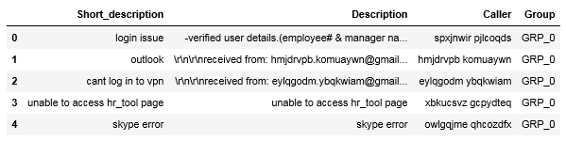
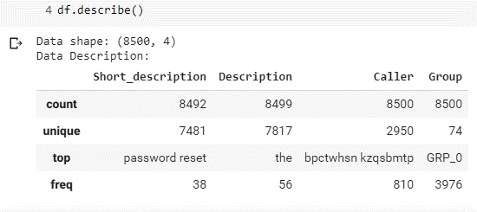
Step1: Data Exploration
The dataset has 4 columns: Short_description, Description, Caller, and Group
The dataset has total 8500 records
There are missing values in short description and Description columns.
The maximum times the short description has been repeated is 38
The maximum times the Description has been repeated in 56
The maximum times the caller has repeated is 810
The maximum times a group is assigned ticket is 3976
First five records of the data
Analysing data with describe() function

Slide 6
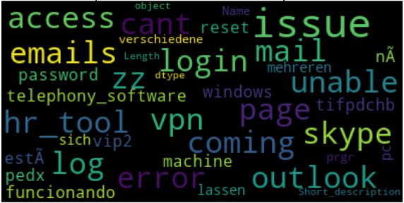
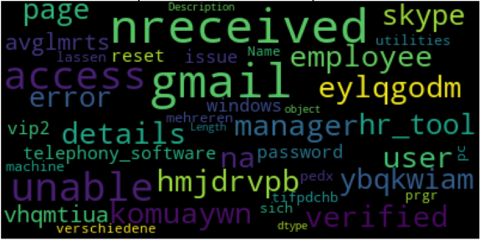
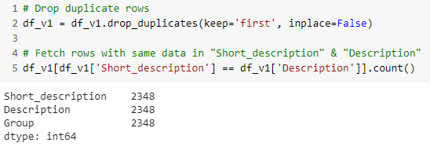
Step2: Analyzing Features with WordCloud
Most Frequent Words in Short Description Column
Most Frequent Words in Description Column
Checking to see if Description and Short_description columns have same data, we see that there are 2862 records that have exactly same data in both the columns.

Slide 7
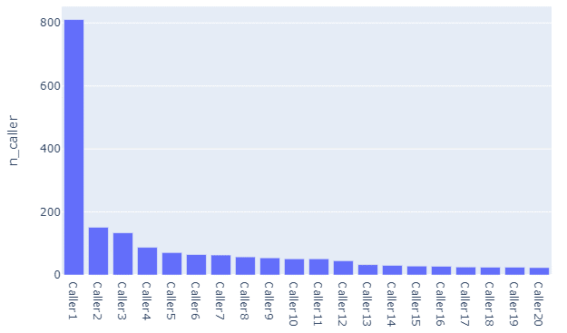
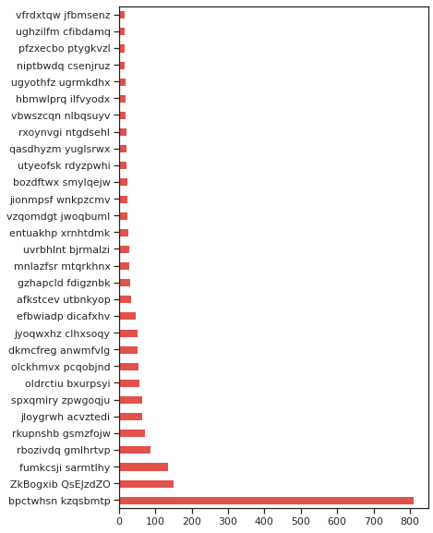
Step2: Caller Feature Visualization
Plotting Caller column after renaming the caller data
Caller column gives the details of callers that reported issue
One caller has reported 810 tickets
The distribution is skewed.
This disparity could be a batch job or an anomaly and should be considered for discussion with domain expert. We are not taking up further analysis of caller for this project.
Plotting Caller column before renaming Caller ID

Slide 8
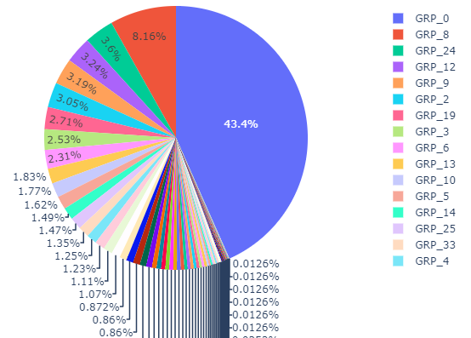
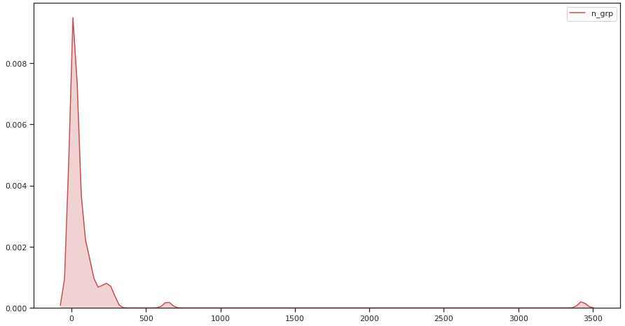
Step2: Group Feature Visualization
Frequency distribution of Group column
Pie chart to understand the class distribution
There are total of 74 groups to which tickets are assigned to. The ticket assignment is not symmetric and few groups have as minimum as one ticket assigned. The data has a class imbalance.

Slide 9
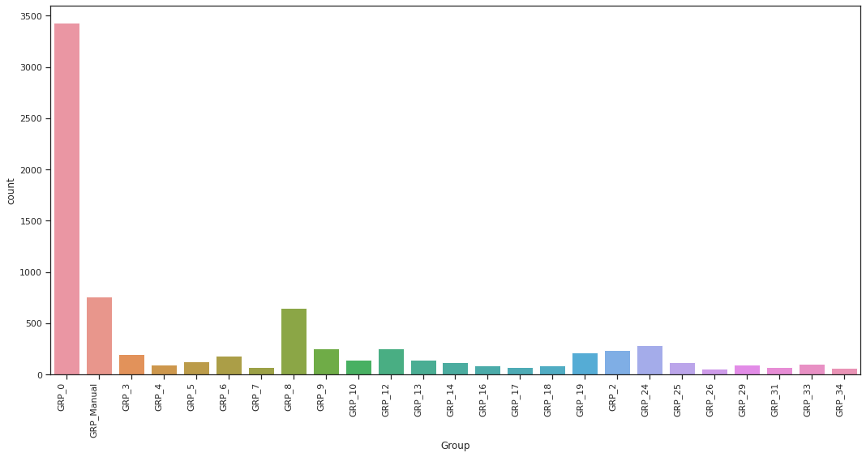
Step2: Address Class Imbalance
To address imbalanced class in this project, we merge minority classes into one group. Where number of tickets in the category is less than specified frequency, we mark them into "GRP_Manual".
All "GRP_Manual" tickets need be triaged manually, until the model has enough data to categorize them automatically. Merging the minority class will improve the F1 score as we classify less assigned class into a group.
Bar plot after grouping the less assigned class (minority class) into one group (GRP_Manual) showing 25 groups

Slide 10
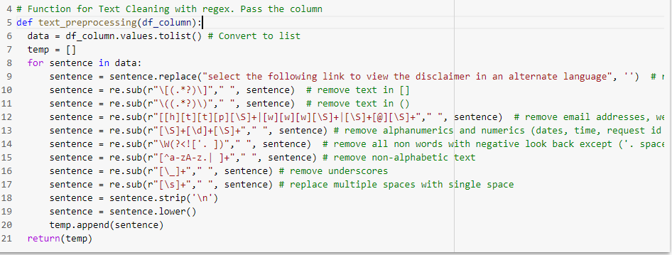
Step3:Text Preprocessing
REGEX
NLTK
CUSTOM
KERAS
Text Cleaning with regex – expanding contractions(can’t = cannot etc), removing emails, urls, dates, time, braces, special chars. Convert text to lowercase
Removal of stop words, non-English words, Tokenise, Lemmatization
Remove duplicate tokens from each record. Set length of tokens in each record to max 20
Create embeddings using tf.Keras.Embeddings layer
By Regular Expression, we clean text for
Insignificant text – remove email addresses, test in braces, numerical/alpha numerical and symbols
Punctuations- all punctuations, extra spaces, and special characters are removed
Capital case - a mixture of uppercase and lowercase words are changed to lowercase

Slide 11
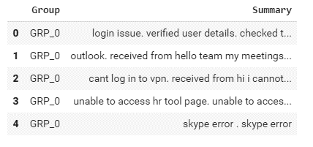
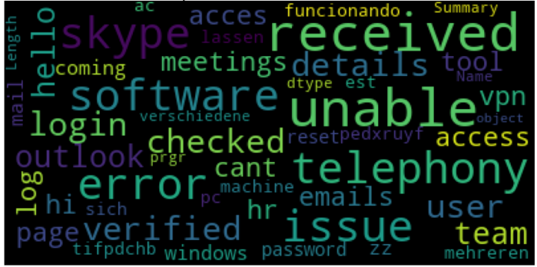
Step3: Cleaned Text
The preprocessed data is then concatenated into a single column called ‘Summary’
Word cloud of text after cleaning and concatenating Short Description and description columns

Slide 12
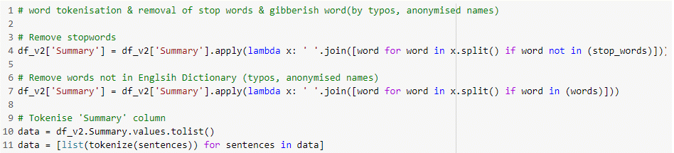
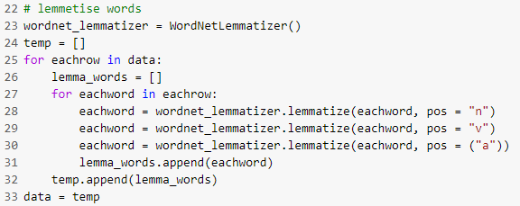
Step4: Tokenize and Lemmatize
Remove stopwords using English stopwords from NLTK
Tokenize sentences using genism tokenise
Lemmatize workds using wordnet_Lemmatizer from NLTK
Tokenization is to split into words, phrases, symbols, or elements called tokens
Lemmatise is to eliminate prefix or suffix of a word and extracting the base word (lemma).

Slide 13
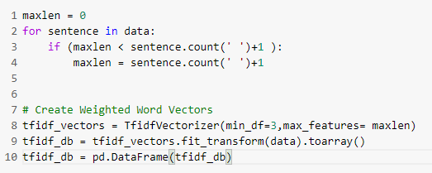
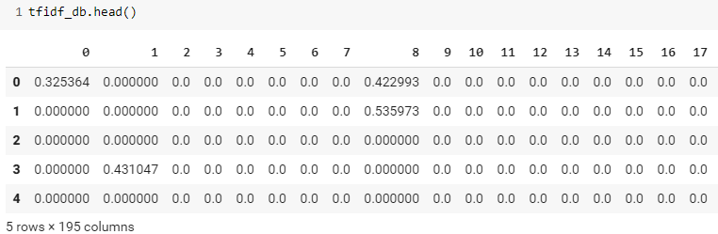
Step4:Vectorization- TF IDF
TF IDF is embedding weighted words where term-frequency~(TF) and TF-IDF each word will be mapped to a number corresponding to the number of occurrence of that word in the whole corpora.
Features transformed to 195 dimensions after TF IDF transformation

Slide 14
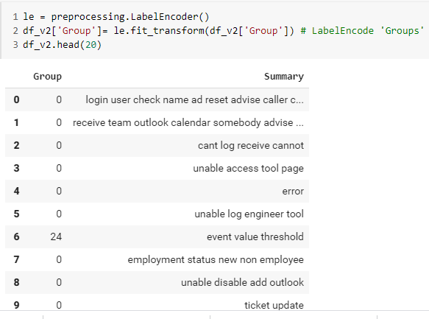
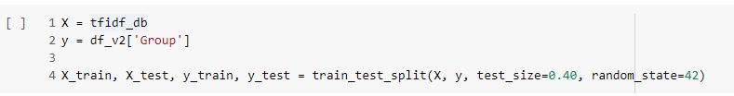
Step4:Label Encoding and X, y split
‘Group’ column is coded to numerical labels with LabelEncoder() function.
The X(input data) is mapped to the vectorized data and y(target) to encoded groups to build our models.
The training and testing datasets are split from the X and y data, in a ratio of 60-40 respectively using the train_test_split() function.

Slide 15
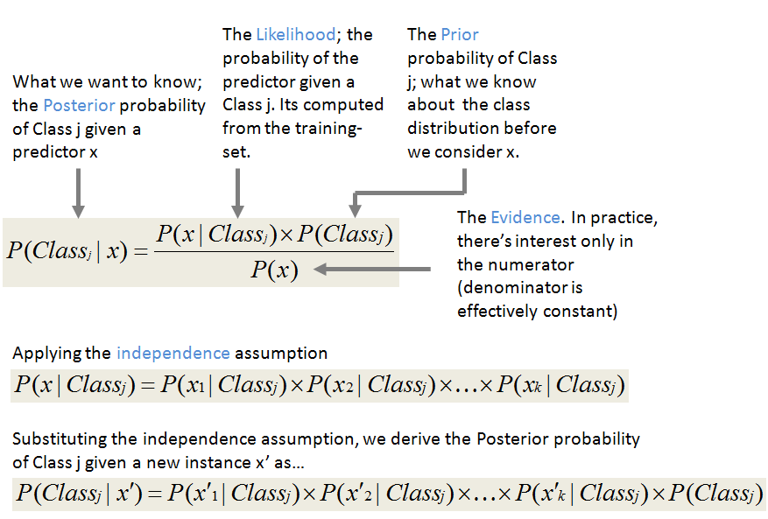
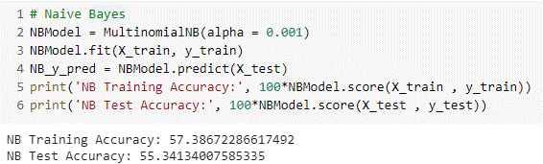
Step5:Basic Models – Multinomial Naïve Bayes
Pros
Cons
Zero frequency - If training data set gets a category not trained on earlier, then model will assign a 0 (zero) probability and will be unable to make a prediction.
Performs better with less training data as it assumes feature independence
Assumptions of independent feature cannot represent real time data.
Simple, fast and well in multi class prediction.
Bad estimator hence the probability outputs are not taken too seriously.
Training accuracy is 57%
testing accuracy is 55%
Pic Source: http://shatterline.com/blog/2013/09/12/not-so-naive-classification-with-the-naive-bayes-classifier/

Slide 16
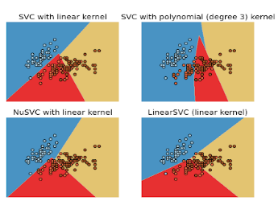
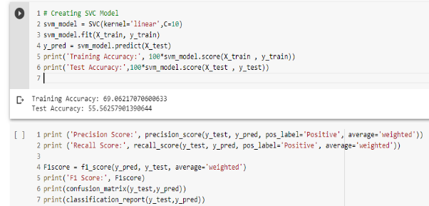
Step5:Model – Support Vector Classifier
Pros
Cons
Good generalization capabilities which prevents it from over-fitting
Choosing an appropriate Kernel function for handling the non-linear data could be tricky and complex
Effective where number of features are greater than the number of samples.
Does not perform very well when the data of target classes are overlapping.
Less affected by outliers, relatively computationally efficient and accurate than its competitors.
Training accuracy is 69%
testing accuracy is 55%
The linear kernel equation for predicting a new input using the dot product between the input (x) and each support vector (xi) is calculated as
f(x) = B(0) + sum(ai * (x,xi))
Pic Source: http://scikit-learn.sourceforge.net/0.8/modules/svm.html

Slide 17
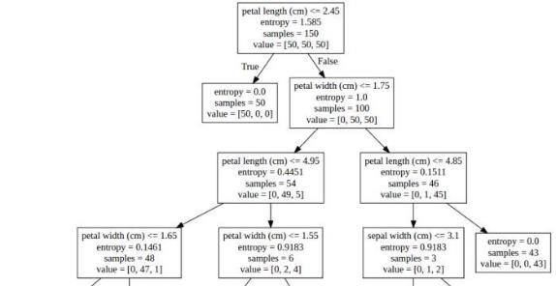
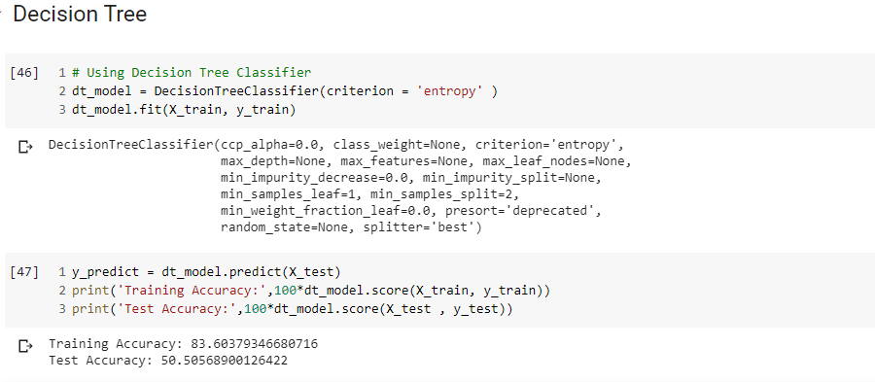
Step5: Model - Decision Tree
Missing values does not affect decision tree.
Requires less effort for data preparation during pre-processing, does not need scaling or normalization.
The Number of hyper-parameters to be tuned is almost null.
A Decision trees model is very intuitive and Interpretation of a complex Decision Tree model can be simplified by its visualizations
Instable as a small change in the data can cause a large change in the structure of the decision tree.
For a Decision tree sometimes calculation can go far more complex compared to other algorithms.
source: https://www.kdnuggets.com/2017/05/simplifying-decision-tree-interpretation-decision-rules-python.html
Training accuracy is 83%
testing accuracy is 50%

Slide 18
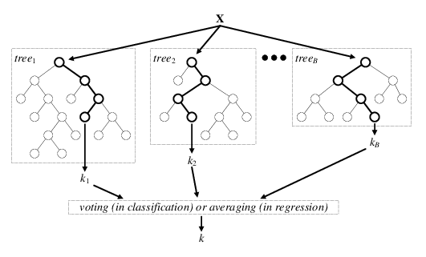
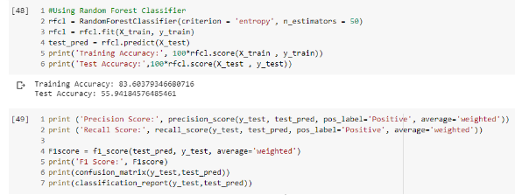
Step5: Model – Random Forest
Random forest is an accurate and robust method because of the number of decision trees participating in the process.
It takes the average of all the predictions, which cancels out the biases thereby does not suffer from the overfitting problem.
Can handle missing values and can be used in both classification and regression problems.
Random forest is slow in generating predictions as it has multiple decision trees. All the trees in the forest must make a prediction then perform voting on it. This whole process is time-consuming.
The model is difficult to interpret compared to a decision tree.
Pic Source: ttps://www.researchgate.net/figure/Architecture-of-the-random-forest-model_fig1_301638643
Training accuracy is 83%
testing accuracy is 55%

Slide 19
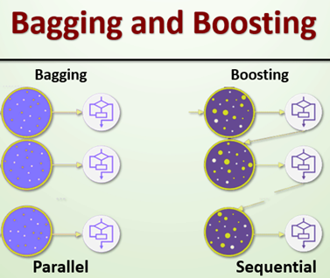
Step5: Model- Ensemble
Classifier | Accuracy
Bagging
Random Forest estimator | 65%
ExtraTrees estimator | 66%
KNeighbour estimator | 63%
SVC estimator | 32%
Ridgeclassifier | 15%
Voting with Bagging
Random Forest estimator | 82%
ExtraTrees estimator | 82%
KNeighbour estimator | 75%
SVC estimator | 82%
Ridgeclassifier | 55%
Pic Source: Capstone\Final Report_Group 3 NLP.docx - _Hlk36732784
Most of the errors from a model’s learning are from three main factors: variance, noise, and bias.
Using ensemble methods, we can increase the stability of the final model and reduce the errors mentioned previously.

Slide 20
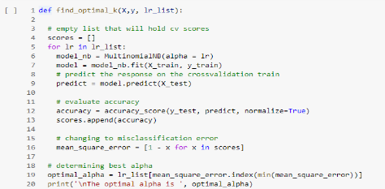
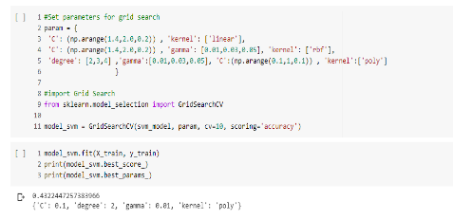
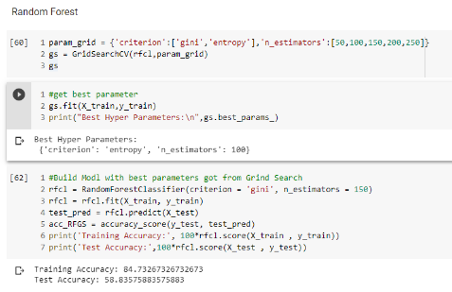
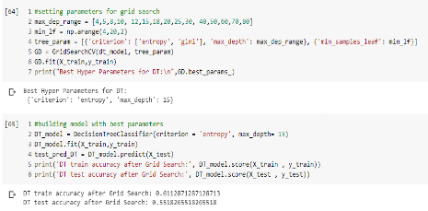
Step6:Model Tunning
Naïve Bayes
SVC
55% accuracy
43% accuracy
Decision Tree
Random Forest
55% accuracy
58% accuracy

Slide 21
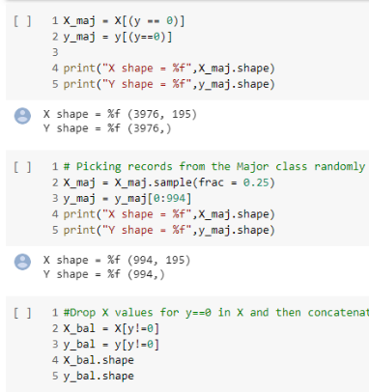
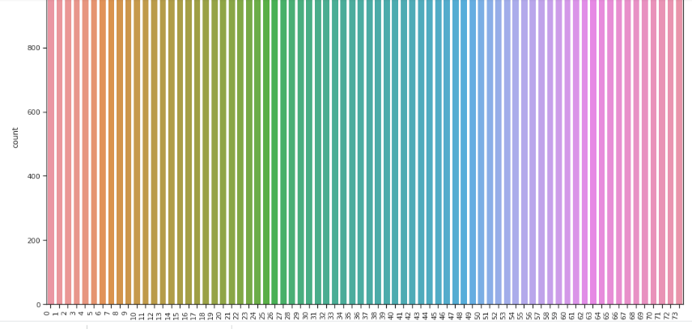
Step6:Random Sampling
Random select 25
5% of majority Class
Select Minority class and apply over sampling
Concatenate the Randomly selected data
Plotting the count of observations in each group after random sampling

Slide 22
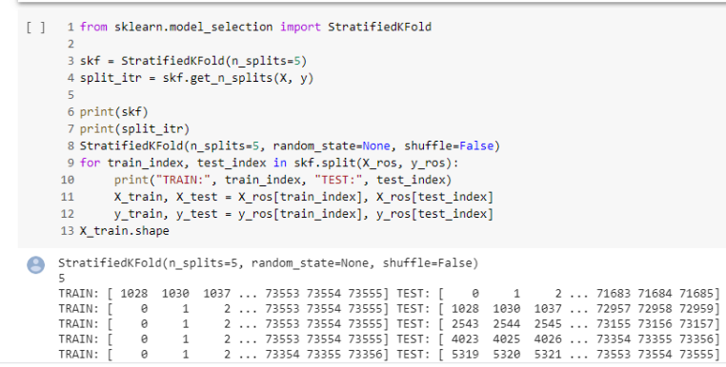
Step6: Stratified KFold
N_splits = 5
Without Shuffle
No Random state
Selecting Train/test data
Selecting the data for training/testing in such a way that each fold has whole representation of all the classes with Stratified KFold

Slide 23
Accuracy of Models after Sampling
Traditional Models
Models after tuning
Naive Bayes
Naïve Bayes
Train: 72%
Test: 72%
Train: 73%
Test: 72%
SVC
SVC
Train:80%
Test: 59%
Train: 73%
Test: 59%
Decision Tree & Random Forest
Decision Tree
Train:86%
Test: 85%
Train: 85%
Test:84%
Ensemble
Random Forest
Test: 60%
Train: 86%
Test: 86%

Slide 24

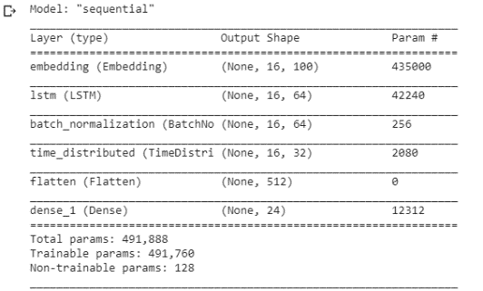
Step7: RNN - LSTM
LSTM
Glove 100d pretrained vectors
Sequential
Bidirectional model
6 layers with 491,760 trainable parameters
Adam Optimizer & Sparse categorical cross entropy loss
Capstone\Final Report_Group 3 NLP.docx - _Hlk36732784
Training accuracy: 90.6%
Test accuracy: 88.1%
Validation accuracy: 87.8%
AUC is 94%

Slide 25
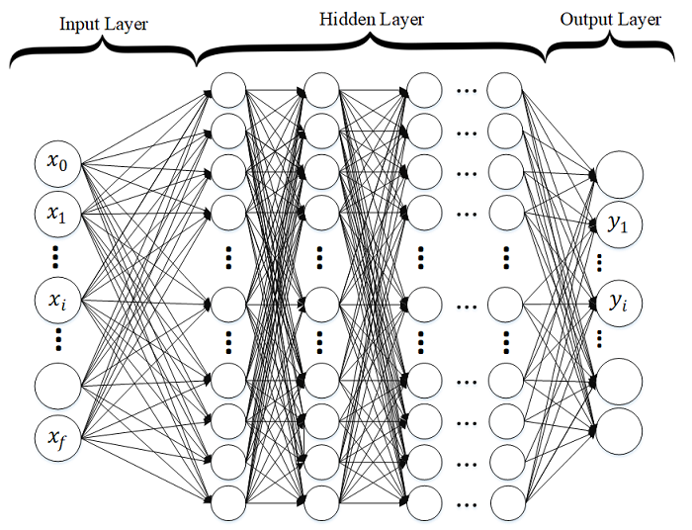
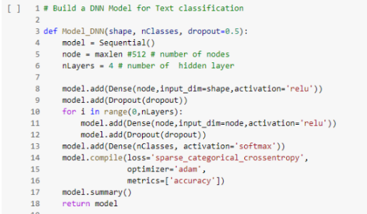
Step7: DNN- Model
DNN # | DNN Architecture | Accuracy (%)
 |  | Training | Testing
1 | 367 nodes in all the 4 layers. Dropout =0.5. | 85.30 | 84.70
2 | same architecture as DNN1, hidden nodes = 367*2 | 85.66 | 84.74
3 | 367 nodes in all the 8 layers. Dropout =0.5 | 31.54 | 30.75
4 | Same input as DNN2 with 8 layers. | 71.89 | 70.72
5 | Same input as DNN1 with Dropout =0.2. | 86.12 | 84.95
6 | Same input as DNN1 without Dropout. | 85.76 | 84.63
7 | NN layers- 1 input, 1 output and 1 hidden layer, no dropout. | 86.35 | 85.43
8 | With sigmoid activation instead of relu in the hidden layers | 82.55 | 81.27
9 | Same input as DNN1 with reduction in the hidden nodes by half the input nodes (367). | 86.19 | 85.03
Train Accuracy is 86%
Test Accuracy is 85%
AUC is 92%

Slide 26
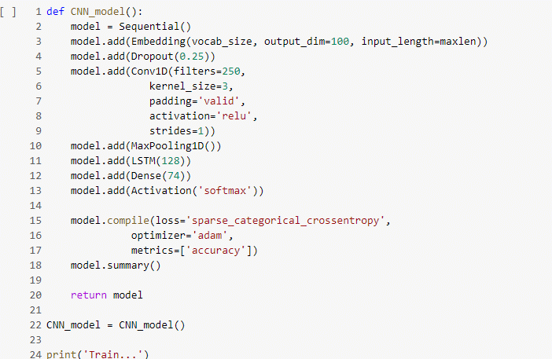
Step7: RCNN Model
Pros
Tackles bias problems of RNN
Cons
Training intensive.
Better captures the contextual information
Combination model that uses the strengths of both RNN and CNN combined.
capture the contextual information
Convolutional Neural Network (CNN)
Recurrent Neural Network (RNN
RCNN
Train accuracy is 87%
AUC is 93%

Slide 27
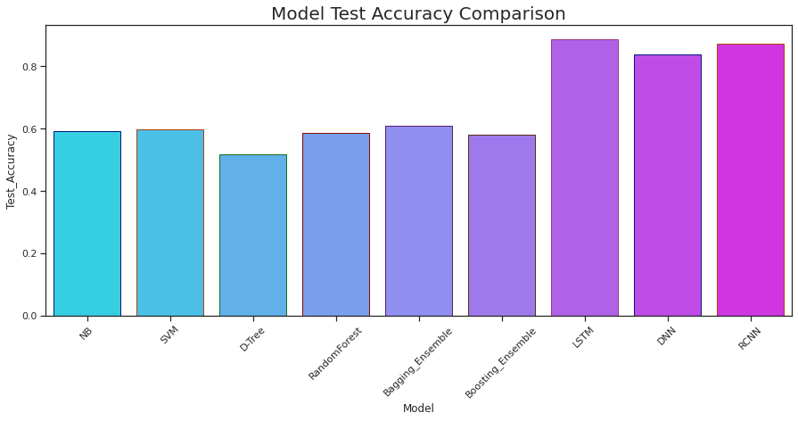
Model Comparison
Model | Train Accuracy | Test Accuracy | Precision | Recall | F1 score
Naive Bayes(Multinomial) | 72.9 | 72.06 | 78.11 | 72.06 | 71.66
SVC(kernel='linear') | 80.81 | 59.9 | 53.34 | 59.9 | 65.26
Decision Tree | 86.59 | 85.51 | 93.92 | 85.51 | 84.1
Random Forest | 86.59 | 85.81 | 94.28 | 85.81 | 84.31
Ensemble(Bagging) | - | 60 | - | - | -
Ensemble(Boosting) | - | 60 | - | - | -
Naive Bayes(Multinomial) (hyperparameter) | 73 | 72.18 | 78.26 | 72.18 | 71.76
SVM(hyperparameter) | 73.62 | 59.04 | 54.87 | 59.04 | 69.95
Decision Tree(hyperparameter) | 85.32 | 84.16 | 93.78 | 84.16 | 82.39
Random Forest(hyperparameter) | 86.84 | 86.29 | - | - | -
DNN5 | 86.45 | 85.5 | - | - | -
DNN9 | 86.48 | 84.75 | - | - | -
LSTM | - | 88 | 94 | 90 | 90
The model is robust to be deployed in production with the accuracy attained; however, the model can be further improved if:
Non-English text is translated and included for model learning
Considerable data available pertaining to the minority classes for better learning (We have upsampled the minority classes for this project.)

Slide 28
Challenges
Challenge | Approach |  | Mitigation
1. Hardware
Personal machines used for the project has limited in storage and processing power. | Find easy and free platforms with sufficient hardware and processing support. | The platform which was used to achieve the task was - Google Colab which provides around 15GB of Storage space on the Google Drive as well as its GPU which empowers us to train and test our models effectively.
Data is the most importance piece of the puzzle with regards to Machine Learning(ML) problems. Our observations are as follows:
2. Class Imbalance
We can observe that the number of observations in each group is poorly distributed. There are totally 74 groups with some groups having as less as one observation. | Use sampling techniques would enable us to down sample the majority classes or/and upsample the minority classes. Group the minority classes into one group for classification | We created a group clubbing the minority classes into one group. Groups having less than 50 tickets will be categorized into one group. We also used upsampling with stratification and downsampling of majority class for Neural Network model. This increased the accuracy and precision.

Slide 29
Challenges
3. Noisy Data
Data collected from the systems would be noisy with extra characters like punctuations, html texts, special characters etc. | Cleaning data is the primary task to any data modelling problem. We spend a considerable amount of time cleaning the data and preparing it for modelling. | In the view of preparing the data for modelling, we must first clean the data. This has been accomplished using NLTK and RE (regular expressions) Libraries.
4. Multi-lingual data
Besides English, we observed non-English text in the dataset. | We checked if libraries from Google Translate and other language translation modules would work for our purpose. However, the limitations exceeded the cause. As a part of the text processing activity, English text has been considered and any other non-English text was dropped. | For milestone 1, we considered only English text for the processing and would address the non-English text either through a translation or a mechanism to map the same using word mappings. The findings would be potentially shared in Milestone 2.
5. Collaboration
The team is located in different parts of the country and the course is completely online which posed a challenge in communication and collaboration. | As a team, the primary goal is to be able to share data between the team, communicate effectively and thereby work together. | We used the following platforms which proved efficient in meeting our team’s expectations and goals. a. Github b. Google Drive c. Telephony, Whatsapp groups, etc.

Slide 30
Insights and Other Approaches
Further Approach
Insights
This project considers only the English text for model, which can be improved if non-English texts are considered after translation
Dropping the minority classes where the data is as less as one ticket
Selecting fixed number of samples from each class in such a way that the sample size has equal representation of each class
Adding/ Leaving out the caller feature to the model building and see the predictions and difference
Adding NMT and translate all the data to English before processing
Create an API and expose parameters such as exclude caller, frequency threshold etc so that the IT Business admin can set them manually
Applying NMT was considered; however, within given timeframe we were unable to incorporate this.
The dataset was highly imbalanced and we have applied sampling techniques to address the issue. In the production scenario, the accuracy could improve if we could get more data especially for minority class.

Slide 31
Summary and Conclusion
Conclusion
The average accuracy with basic model is around:
With over sampling and stratified Kfold, the average accuracy is around:
Test accuracy for DNN model is 85%
Test accuracy for LSTM model is 88%
For this dataset, LTSM model gives the best accuracy.
Loaded the data from https://drive.google.com/drive/u/0/folders/1xOCdNI2R5hiodskIJbj-QySMQs6ccehL
Summary
Analyzed each feature in the given dataset
Found null values and imputed them, found duplicated values and removed them
Cleaned the text in each feature for unwanted characters
Concatenated all the features, created weighted vectors and split them into train and test
Built basic models such as Naïve Bayes, SVC, Decision Tree, Random Forest, and Ensemble
Tuned the model to get optimal accuracy by using Grid Search
Applied random sampling techniques to address class imbalance
Built DNN and LSTM model
With 95% confidence level, true classification error for LSTM will be between 0.0 to 0.006

Slide 32
Thank You

